Slide 1

AGILE OR WATERFALL? What’s the best approach?
Jay’Den Embrey

Slide 2

Agenda
Agile Roles
Agile Phases
Waterfall
Waterfall or Agile/Scrum?

Slide 3

Agile roles
PRODUCT OWNER:
The product owner is responsible for ensuring the value of a product and the work of the development team is raised to its highest potential. The product manager also:
Manages the product backlog.
Makes sure the product backlog is clear and transparent to all involved in the project.
SCRUM MASTER:
The Scrum Master is responsible for ensuring the Scrum team adheres to Scrum theory, values, and practices. The Scrum Manager:
Ensures the Scrum team is adhering to Scrum theory, principles, and practices.
Find methods to improve product backlog management.
Facilitating Scrum Events.
Assists the development team with their progress,
DEVELOPMENT TEAM:
The development team is responsible for producing a high-quality, functional product at the end of a sprint. Development teams:
Consists of testers and developers.
Are considered to be self-organizing.
Are designed to be cross-functional.

Slide 4
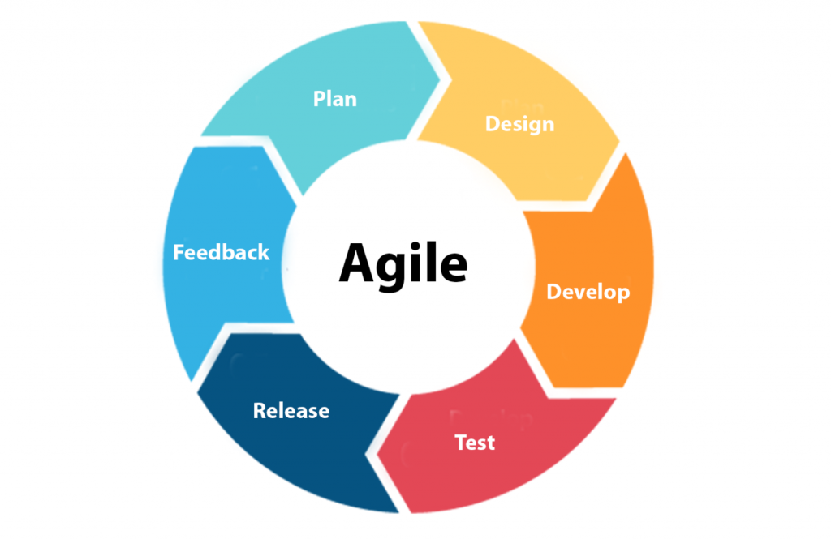
Agile Phases
Requirements Gathering & Planning:
Using a people-over-processes logic, the team analyzes and assembles a plan based on user requirements.
Design:
Using defined requirements, the development team works with the product owner and stakeholders to further define requirements.
Development:
Once requirements have been completely defined, Sprints begin. These typically span from 1-4 weeks in an Agile environment.
Testing:
Development teams debug products and ensure it is functional and meets requirements.
Feedback:
- The development team receives feedback from clients and end users.
This Photo by Unknown Author is licensed under CC BY

Slide 5
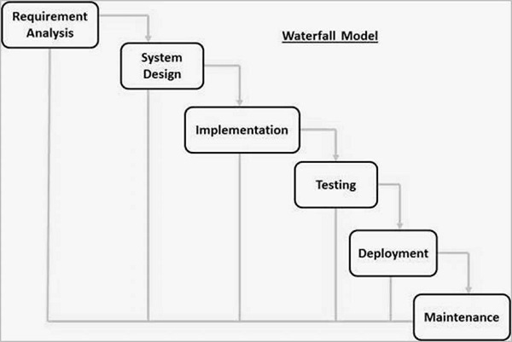
Waterfall
Waterfall incorporates many of the same phases that Agile does. However, once a project enters its integration stage, changes CANNOT be made.
In a project where changes have been made during a waterfall model, changing requirements cannot be accommodated. Therefore, a project might result in failure or need to be restarted.

Slide 6
Waterfall or agile?
Pros:
Simple model for product creation.
Easy to manage.
Phases are outlined and followed, one at a time.
Process and results are documented well.
Cons:
Working software isn’t created until the end of the project.
Changes can fail the project.
Not good for large projects.
Pros:
Easy to manage.
Products are partially working earlier in development.
Change is accepted with minimal impact on the overall project.
Promotes cross-functionality, teamwork, and training.
Cons:
Customer interaction heavily drives product outcome.
Risks to agile management make it hard to predict the outcome.
Lack of documentation.
Not a good model for complex dependencies.

Slide 7
References
Aha! (2024, April 9). User story mapping: Practical templates and examples: AHA! software. User Story Mapping: Practical Templates and Examples | Aha! software. https://www.aha.io/roadmapping/guide/release-management/what-is-user-story-mapping
Charles G. Cobb. (2015). The Project Manager’s Guide to Mastering Agile : Principles and Practices for an Adaptive Approach. Wiley.
SDLC - Agile Model. Tutorialspoint. (n.d.). https://www.tutorialspoint.com/sdlc/sdlc_agile_model.htm

